Slide 1
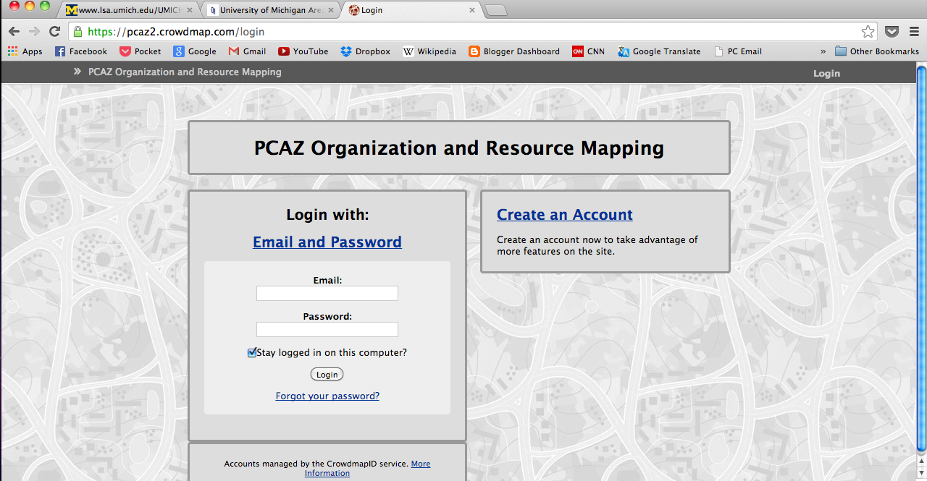
http://pcaz2.crowdmap.com
Log-in with your email address and password:
Peace100
The wifi password is: 443 1070 443 on “amb” or “amb-restaurant”

Slide 2
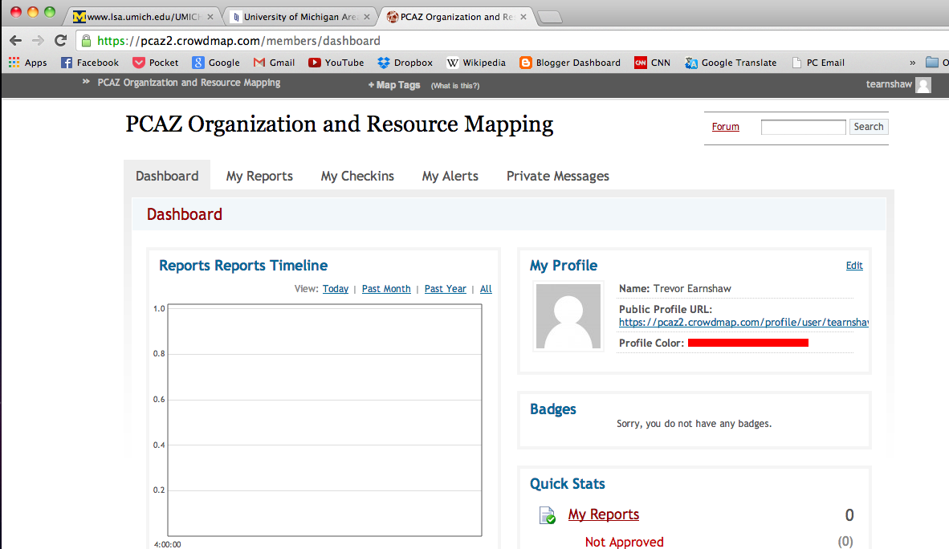
This is your home screen.
Click here to view the map.

Slide 3
SCENARIO 3
Paula Abdul, AZ10, has been assigned to a small, non-bank credit organization called Loans to the Poor LLC in Yevlax. Her director and CP are kind, but they haven’t engaged her much in work, but she’s been in contact with the org’s HQ in Baku. She’s been able to develop projects (employee satisfaction survey and women’s entrepreneurship program) but they haven’t been implemented by the organization yet. There is strong support from the top, but low motivation at the bottom to actually carry out activities. She hopes she will be able to implement both projects within the next year.

Slide 4
SCENARIO 4
Randy Jackson is a 22 year old PCV who started PST in April 2013. He lives in a village in Sabirabad but was assigned to work teaching English classes at a school in Sabirabad city. Two months ago, he started a softball team made of 8th-10th grade male students who liked playing football after conversation club. He practices twice a week, but they haven’t participated in a tournament yet. Yusif Muellim (550-555-0100) is a Geography teacher who comes to practices, learned softball rules, keeps kids in line and offered to accompany Randy and the kids to the tournaments.

Slide 5
SCENARIO 1
Az10 Mark Jones is a TEFL assigned to School #139 in Baku. His main counterpart is Afet Guliyeva (051-666-8888). You teach 15 English classes per week forms 5-10 with 6 English teacher counterparts. Other than Afet, the others don’t speak much English, and they aren’t very friendly to you. You have a hard time speaking to them in Azerbaijani, but you manage to squeeze in 15 classes per week. You lesson plan with Afet, but the others teachers aren’t interested. They often complain about an AZ5 who worked there in the past. The school director, however, is thrilled to have you there and supports all of your activities. You have a student volunteer club, computer lessons and a conversation club that meets twice per week.

Slide 6
SCENARIO 2
I’m Sally Fourth a female YD Az11 in Xachmaz. There is a park in Xachmaz city that is friendly during the daytime as long as you don’t linger on a park bench. At night, avoid the area by the large map of Azerbaijan. The park is male dominated—don’t be alarmed to see mostly men there. However, women occasionally walk through, and it is OK for female PCVs to be seen there. My male PCV friends feel comfortable hanging out there too.

